Slide 1
Docker
Packaging application with dependencies

Slide 2
Docker Image
We create docker image with packaging application with dependences.

Slide 3
Docker container
Running instance of docker image.

Slide 4
Docker image Instruction
Link: https://docs.docker.com/reference/dockerfile/

Slide 5
Build Context
Text file that we use to create docker Image[Dockerfile]

Slide 6
Create and run the docker image
Build: docker build -t <ImageName>:<tagName> .
Run: docker run <ImageName>:<tagName>

Slide 7
FROM
FROM is used to set the base image for our application.
FROM <OS-Name>
Rule for Docker image size optimization:
1) Choose the best OS Image
Example: My requirement is, I want to print hello world, and 3 available OS are ubuntu, alpine and centos.
2) Choose the highly provisioned docker image to provision time.

Slide 8
RUN
RUN command is used for provision
Syntax: RUN <Provision command>
2) When we are running any build steps
Syntax: RUN <Build command>

Slide 9
CMD
When you want to run the application on provisioned server.
Syntax: CMD <RUN command>

Slide 10
ENTRYPOINT
Same as CMD, but here command and argument are fixed

Slide 11
Docker image with RUN CMD and ENTRYPOINT
FROM alpine
CMD ["echo", "Hello Docker"]
FROM alpine
ENTRYPOINT [“ping"]
CMD [“localhost"]

Slide 12
WORKDIR
To change the directory
Syntax: WORKDIR <Directory> #RUN cd

Slide 13
USER
To assign owner of image.
Background: By default docker run with root user, so if we need to assign any user as owner of docker image then we need to use USER
Syntax: USER <user>

Slide 14
EXPOSE
To open any port
Syntax: EXPOSE <Port>
Note: If we are not exposing port then docker will randomly assign the port.

Slide 15
ADD
FROM ubuntu
RUN apt-get update
RUN apt install unzip -y
ADD https://releases.hashicorp.com/terraform/1.8.5/terraform_1.8.5_linux_386.zip .
RUN unzip terraform_1.8.5_linux_386.zip
Note: As a part of Docker image optimization we need to remove zip file as well.

Slide 16
COPY
# Use the official Nginx image as a parent image
FROM nginx:alpine
# Set the working directory
WORKDIR /usr/share/nginx/html
# Copy the index.html file to the working directory in the container
COPY html/index.html .
# Expose port 80 to the outside world
EXPOSE 80

Slide 17
ARG
The ARG instruction defines a variable that users can pass at build-time to the builder with the docker build command using the --build-arg <varname>=<value> flag.
ARG BASE_IMAGE=nginx:alpine
FROM ${BASE_IMAGE}
WORKDIR /usr/share/nginx/html
COPY html/index.html .
EXPOSE 80
docker build -t my-nginx-app --build-arg BASE_IMAGE=nginx:latest .

Slide 18
ENV > To set environment variable
# Use the official MySQL image
FROM mysql:8.0
# Set environment variables for MySQL
ENV MYSQL_ROOT_PASSWORD=root
ENV MYSQL_DATABASE=mydb
# Expose port 3306
EXPOSE 3306
# Start MySQL
CMD ["mysqld"]

Slide 19
LABEL
The LABEL instruction adds metadata to an image. A LABEL is a key-value pair. To include spaces within a LABEL value, use quotes and backslashes as you would in command-line parsing. A few usage examples:
LABEL "com.example.vendor"="ACME Incorporated"
LABEL com.example.label-with-value="foo"
LABEL version="1.0"

Slide 20
HEALTHCHECK
HEALTHCHECK --interval=5m --timeout=3s \
CMD curl -f http://localhost/ || exit 1
<Not using in realtime>

Slide 21
STOPSIGNAL
The STOPSIGNAL instruction sets the system call signal that will be sent to the container to exit. This signal can be a signal name in the format SIG<NAME>, for instance SIGKILL, or an unsigned number that matches a position in the kernel's syscall table, for instance 9. The default is SIGTERM if not defined.

Slide 22
MAINTAINER (deprecated)
The MAINTAINER instruction sets the Author field of the generated images. The LABEL instruction is a much more flexible version of this and you should use it instead, as it enables setting any metadata you require, and can be viewed easily, for example with docker inspect. To set a label corresponding to the MAINTAINER field you could use:
MAINTAINER <name>
LABEL authors="SvenDowideit@home.org.au"

Slide 23
ONBUILD
The ONBUILD instruction adds to the image a trigger instruction to be executed at a later time, when the image is used as the base for another build. The trigger will be executed in the context of the downstream build, as if it had been inserted immediately after the FROM instruction in the downstream Dockerfile.
ONBUILD ADD . /app/srcONBUILD
RUN /usr/local/bin/python-build --dir /app/src
Never seen it use in real world

Slide 24
SHELL
The SHELL instruction allows the default shell used for the shell form of commands to be overridden. The default shell on Linux is ["/bin/sh", "-c"], and on Windows is ["cmd", "/S", "/C"]. The SHELL instruction must be written in JSON form in a Dockerfile.

Slide 25
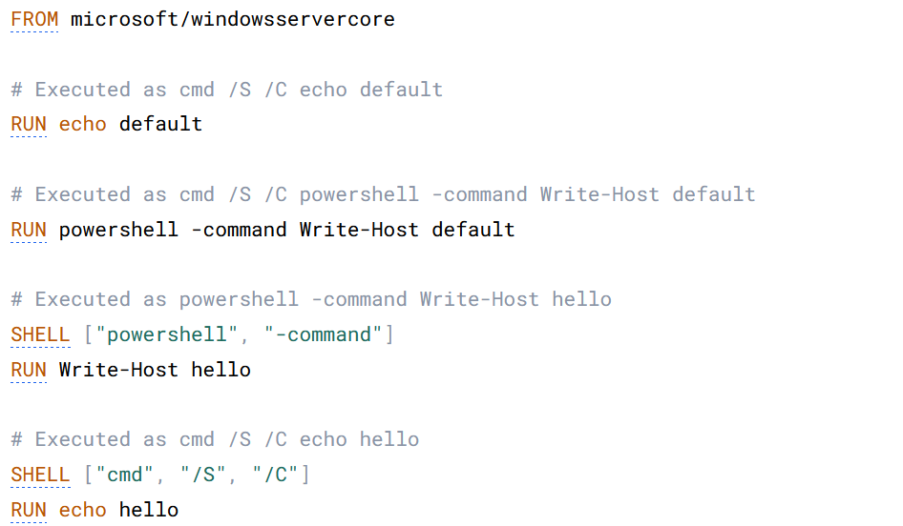
Shell

Slide 26
VOLUME
The VOLUME instruction creates a mount point with the specified name and marks it as holding externally mounted volumes from native host or other containers.
FROM ubuntu
RUN mkdir /myvol
RUN echo "hello world" > /myvol/greeting
VOLUME /myvol

Slide 27
MultiStage Docker build
Multi-stage builds are useful to anyone who has struggled to optimize Dockerfiles while keeping them easy to read and maintain.
With multi-stage builds, you use multiple FROM statements in your Dockerfile. Each FROM instruction can use a different base, and each of them begins a new stage of the build. You can selectively copy artifacts from one stage to another, leaving behind everything you don't want in the final image.

Slide 28
Multistage dockerfile
FROM ubuntu as mvn RUN apt update RUN apt install -y git RUN apt-get update RUN apt install openjdk-17-jre-headless -y RUN git clone https://github.com/spring-projects/spring-petclinic.git WORKDIR spring-petclinic RUN ./mvnw clean package -DskipTests FROM ubuntu RUN apt-get update RUN apt install openjdk-17-jre-headless -y COPY --from=mvn /spring-petclinic/target/spring-petclinic*.jar /spring-petclinic.jar CMD java -jar /spring-petclinic.jar

Slide 29
.dockeringore
A .dockerignore file is used to specify which files and directories should be ignored by the docker build command when creating a Docker image. This can help reduce the build context size, improve build performance, and avoid including unnecessary files in the image.

Slide 30
Docker init
Command line tool used to create docker image.
Command: docker init

Slide 31
Docker compose
Docker Compose is a tool for defining and running multi-container Docker applications. With Docker Compose, you use a YAML file to configure your application's services
Note: Note used in Real time

Slide 32
Docker compose practice
https://github.com/JanbaskDevops/dockerCompose

Slide 33
Key Take away from the class
Use multistage docker build
Use highly provisioned docker image
Use the base image wisely
Use .dockerignore file
Romove unwated zip files if any

Slide 34
What is Docker
Docker package application with dependencies, so it can run anywhere
Advantage is using docker:
No issue after reboot/OS upgrade on Application
Portability[You can run image anywhere] >>Steps for cloud native application design.
No blame culture like application is working on my environment.

